Slide 1

Parallel Programming in C with MPI and OpenMP
Michael J. Quinn

Slide 2
Chapter 18
Combining MPI and OpenMP

Slide 3
Outline
Advantages of using both MPI and OpenMP
Case Study: Conjugate gradient method
Case Study: Jacobi method

Slide 4
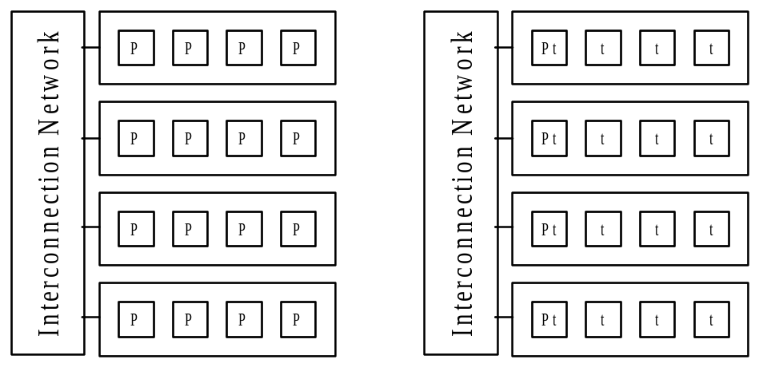
C+MPI vs. C+MPI+OpenMP
C + MPI
C + MPI + OpenMP

Slide 5
Why C + MPI + OpenMP
Can Execute Faster
Lower communication overhead
More portions of program may be practical to parallelize
May allow more overlap of communications with computations

Slide 6
Case Study: Conjugate Gradient
Conjugate gradient method solves Ax = b
In our program we assume A is dense
Methodology
  Start with MPI program
  Profile functions to determine where most execution time spent
  Tackle most time-intensive function first

Slide 7
Result of Profiling MPI Program
Function | 1 CPU | 8 CPUs
matrix_vector_product | 99.55% | 97.49%
dot_product | 0.19% | 1.06%
cg | 0.25% | 1.44%
Clearly our focus needs to be on function
matrix_vector_product

Slide 8
Code for matrix_vector_product
void matrix_vector_product (int id, int p,
int n, double **a, double *b, double *c)
{
int i, j;
double tmp; /* Accumulates sum */
for (i=0; i<BLOCK_SIZE(id,p,n); i++) {
tmp = 0.0;
for (j = 0; j < n; j++)
tmp += a[i][j] * b[j];
piece[i] = tmp;
}
new_replicate_block_vector (id, p,
piece, n, (void *) c, MPI_DOUBLE);
}

Slide 9
Adding OpenMP directives
Want to minimize fork/join overhead by making parallel the outermost possible loop
Outer loop may be executed in parallel if each thread has a private copy of tmp and j
#pragma omp parallel for private(j,tmp)
for (i=0; i<BLOCK_SIZE(id,p,n); i++) {

Slide 10
User Control of Threads
Want to give user opportunity to specify number of active threads per process
Add a call to omp_set_num_threads to function main
Argument comes from command line
omp_set_num_threads (atoi(argv[3]));

Slide 11
What Happened?
We transformed a C+MPI program to a C+MPI+OpenMP program by adding only two lines to our program!

Slide 12
Benchmarking
Target system: a commodity cluster with four dual-processor nodes
C+MPI program executes on 1, 2, ..., 8 CPUs
On 1, 2, 3, 4 CPUs, each process on different node, maximizing memory bandwidth per CPU
C+MPI+OpenMP program executes on 1, 2, 3, 4 processes
Each process has two threads
C+MPI+OpenMP program executes on 2, 4, 6, 8 threads

Slide 13
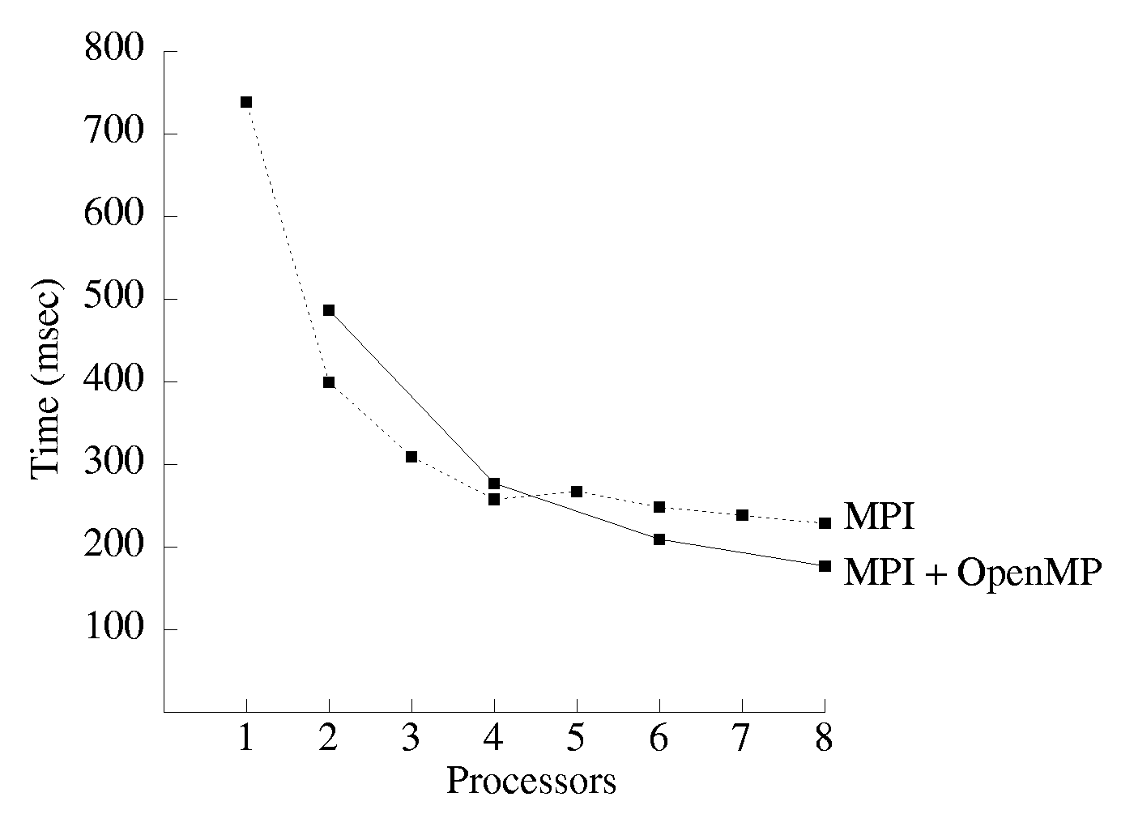
Results of Benchmarking

Slide 14
Analysis of Results
C+MPI+OpenMP program slower on 2, 4 CPUs because C+MPI+OpenMP threads are sharing memory bandwidth, while C+MPI processes are not
C+MPI+OpenMP programs faster on 6, 8 CPUs because they have lower communication cost

Slide 15
Case Study: Jacobi Method
Begin with C+MPI program that uses Jacobi method to solve steady state heat distribution problem of Chapter 13
Program based on rowwise block striped decomposition of two-dimensional matrix containing finite difference mesh

Slide 16
Methodology
Profile execution of C+MPI program
Focus on adding OpenMP directives to most compute-intensive function

Slide 17
Result of Profiling
Function | 1 CPU | 8 CPUs
initialize_mesh | 0.01% | 0.03%
find_steady_state | 98.48% | 93.49%
print_solution | 1.51% | 6.48%

Slide 18
Function find_steady_state (1/2)
its = 0;
for (;;) {
if (id > 0)
MPI_Send (u[1], N, MPI_DOUBLE, id-1, 0,
MPI_COMM_WORLD);
if (id < p-1) {
MPI_Send (u[my_rows-2], N, MPI_DOUBLE, id+1,
0, MPI_COMM_WORLD);
MPI_Recv (u[my_rows-1], N, MPI_DOUBLE, id+1,
0, MPI_COMM_WORLD, &status);
}
if (id > 0)
MPI_Recv (u[0], N, MPI_DOUBLE, id-1, 0,
MPI_COMM_WORLD, &status);

Slide 19
Function find_steady_state (2/2)
diff = 0.0;
for (i = 1; i < my_rows-1; i++)
for (j = 1; j < N-1; j++) {
w[i][j] = (u[i-1][j] + u[i+1][j] +
u[i][j-1] + u[i][j+1])/4.0;
if (fabs(w[i][j] - u[i][j]) > diff)
diff = fabs(w[i][j] - u[i][j]);
}
for (i = 1; i < my_rows-1; i++)
for (j = 1; j < N-1; j++)
u[i][j] = w[i][j];
MPI_Allreduce (&diff, &global_diff, 1,
MPI_DOUBLE, MPI_MAX, MPI_COMM_WORLD);
if (global_diff <= EPSILON) break;
its++;

Slide 20
Making Function Parallel (1/2)
Except for two initializations and a return statement, function is a big for loop
Cannot execute for loop in parallel
  Not in canonical form
  Contains a break statement
  Contains calls to MPI functions
  Data dependences between iterations

Slide 21
Making Function Parallel (2/2)
Focus on first for loop indexed by i
How to handle multiple threads testing/updating diff?
Putting if statement in a critical section would increase overhead and lower speedup
Instead, create private variable tdiff
Thread tests tdiff against diff before call to MPI_Allreduce

Slide 22
Modified Function
diff = 0.0;
#pragma omp parallel private (i, j, tdiff)
{
tdiff = 0.0;
#pragma omp for
for (i = 1; i < my_rows-1; i++)
...
#pragma omp for nowait
for (i = 1; i < my_rows-1; i++)
#pragma omp critical
if (tdiff > diff) diff = tdiff;
}
MPI_Allreduce (&diff, &global_diff, 1,
MPI_DOUBLE, MPI_MAX, MPI_COMM_WORLD);

Slide 23
Making Function Parallel (3/3)
Focus on second for loop indexed by i
Copies elements of w to corresponding elements of u: no problem with executing in parallel

Slide 24
Benchmarking
Target system: a commodity cluster with four dual-processor nodes
C+MPI program executes on 1, 2, ..., 8 CPUs
On 1, 2, 3, 4 CPUs, each process on different node, maximizing memory bandwidth per CPU
C+MPI+OpenMP program executes on 1, 2, 3, 4 processes
Each process has two threads
C+MPI+OpenMP program executes on 2, 4, 6, 8 threads

Slide 25
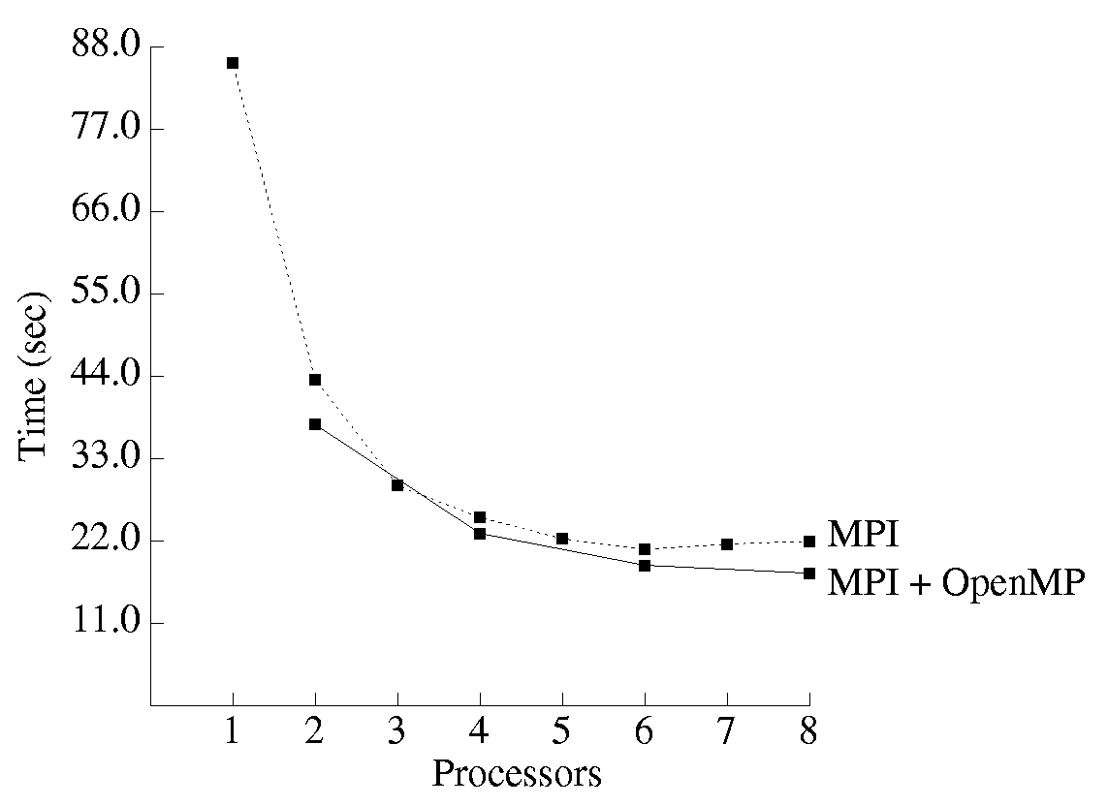
Benchmarking Results

Slide 26
Analysis of Results
Hybrid C+MPI+OpenMP program uniformly faster than C+MPI program
Computation/communication ratio of hybrid program is superior
Number of mesh points per element communicated is twice as high per node for the hybrid program
Lower communication overhead leads to 19% better speedup on 8 CPUs

Slide 27
Summary
Many contemporary parallel computers consists of a collection of multiprocessors
On these systems, performance of C+MPI+OpenMP programs can exceed performance of C+MPI programs
OpenMP enables us to take advantage of shared memory to reduce communication overhead
Often, conversion requires addition of relatively few pragmas

